Slide 1


WORKFORCE PATHWAYS FOR MICRO/NANOTECHNOLGY
Mutual Interest Partnerships Are the Key!
Dr. María L. Villagómez
Assistant Superintendent/Vice President of Academic Affairs
Dr. Jens-Uwe Kuhn
Dean of Math, Sciences, and Engineering

Slide 2



Overview
NSF ATE and Grant Proposal
Partnerships
Award and
On-Going Efforts

Slide 3
Track 1
Small Scale Projects
  $475K
  3 years
  Not limited to new to ATE IHEs
Track 2
Projects
  $1M
  3 years
Track 3
Consortia
  $1.2 - $3M
  3-4 years
  2, 3, or more IHEs
Track 4
Centers
  $7.5M
  5 years
  Pre-defined areas of technology focus
NSF | Advanced Technological Education (ATE)

Slide 4
NSF ATE Areas of Focus
Program Development and Improvement
Professional Development
for Educators
Teacher Preparation
Curriculum and Educational Materials Development
Leadership Capacity Building for Faculty
Entrepreneurial Skills Development for Students
SBCC | UCSB | Industry

Slide 5

Project Goals
  01
Build Industry Relations
  02
Provide Hands-On Learning at UCSB Facilities
  03
Build a Clear Educational and Career Pathway

Slide 6
Stakeholder Roles
1
  2
  3
SBCC
Spearheading Project & Relationships with Local Manufacturing industry
UCSB’s CA NanoSystems Institute
Host the Nanostructures Cleanroom and Nanofab Facilities
Local Industry Partners
Input on critical training needs and collaborate on increasing awareness

Slide 7
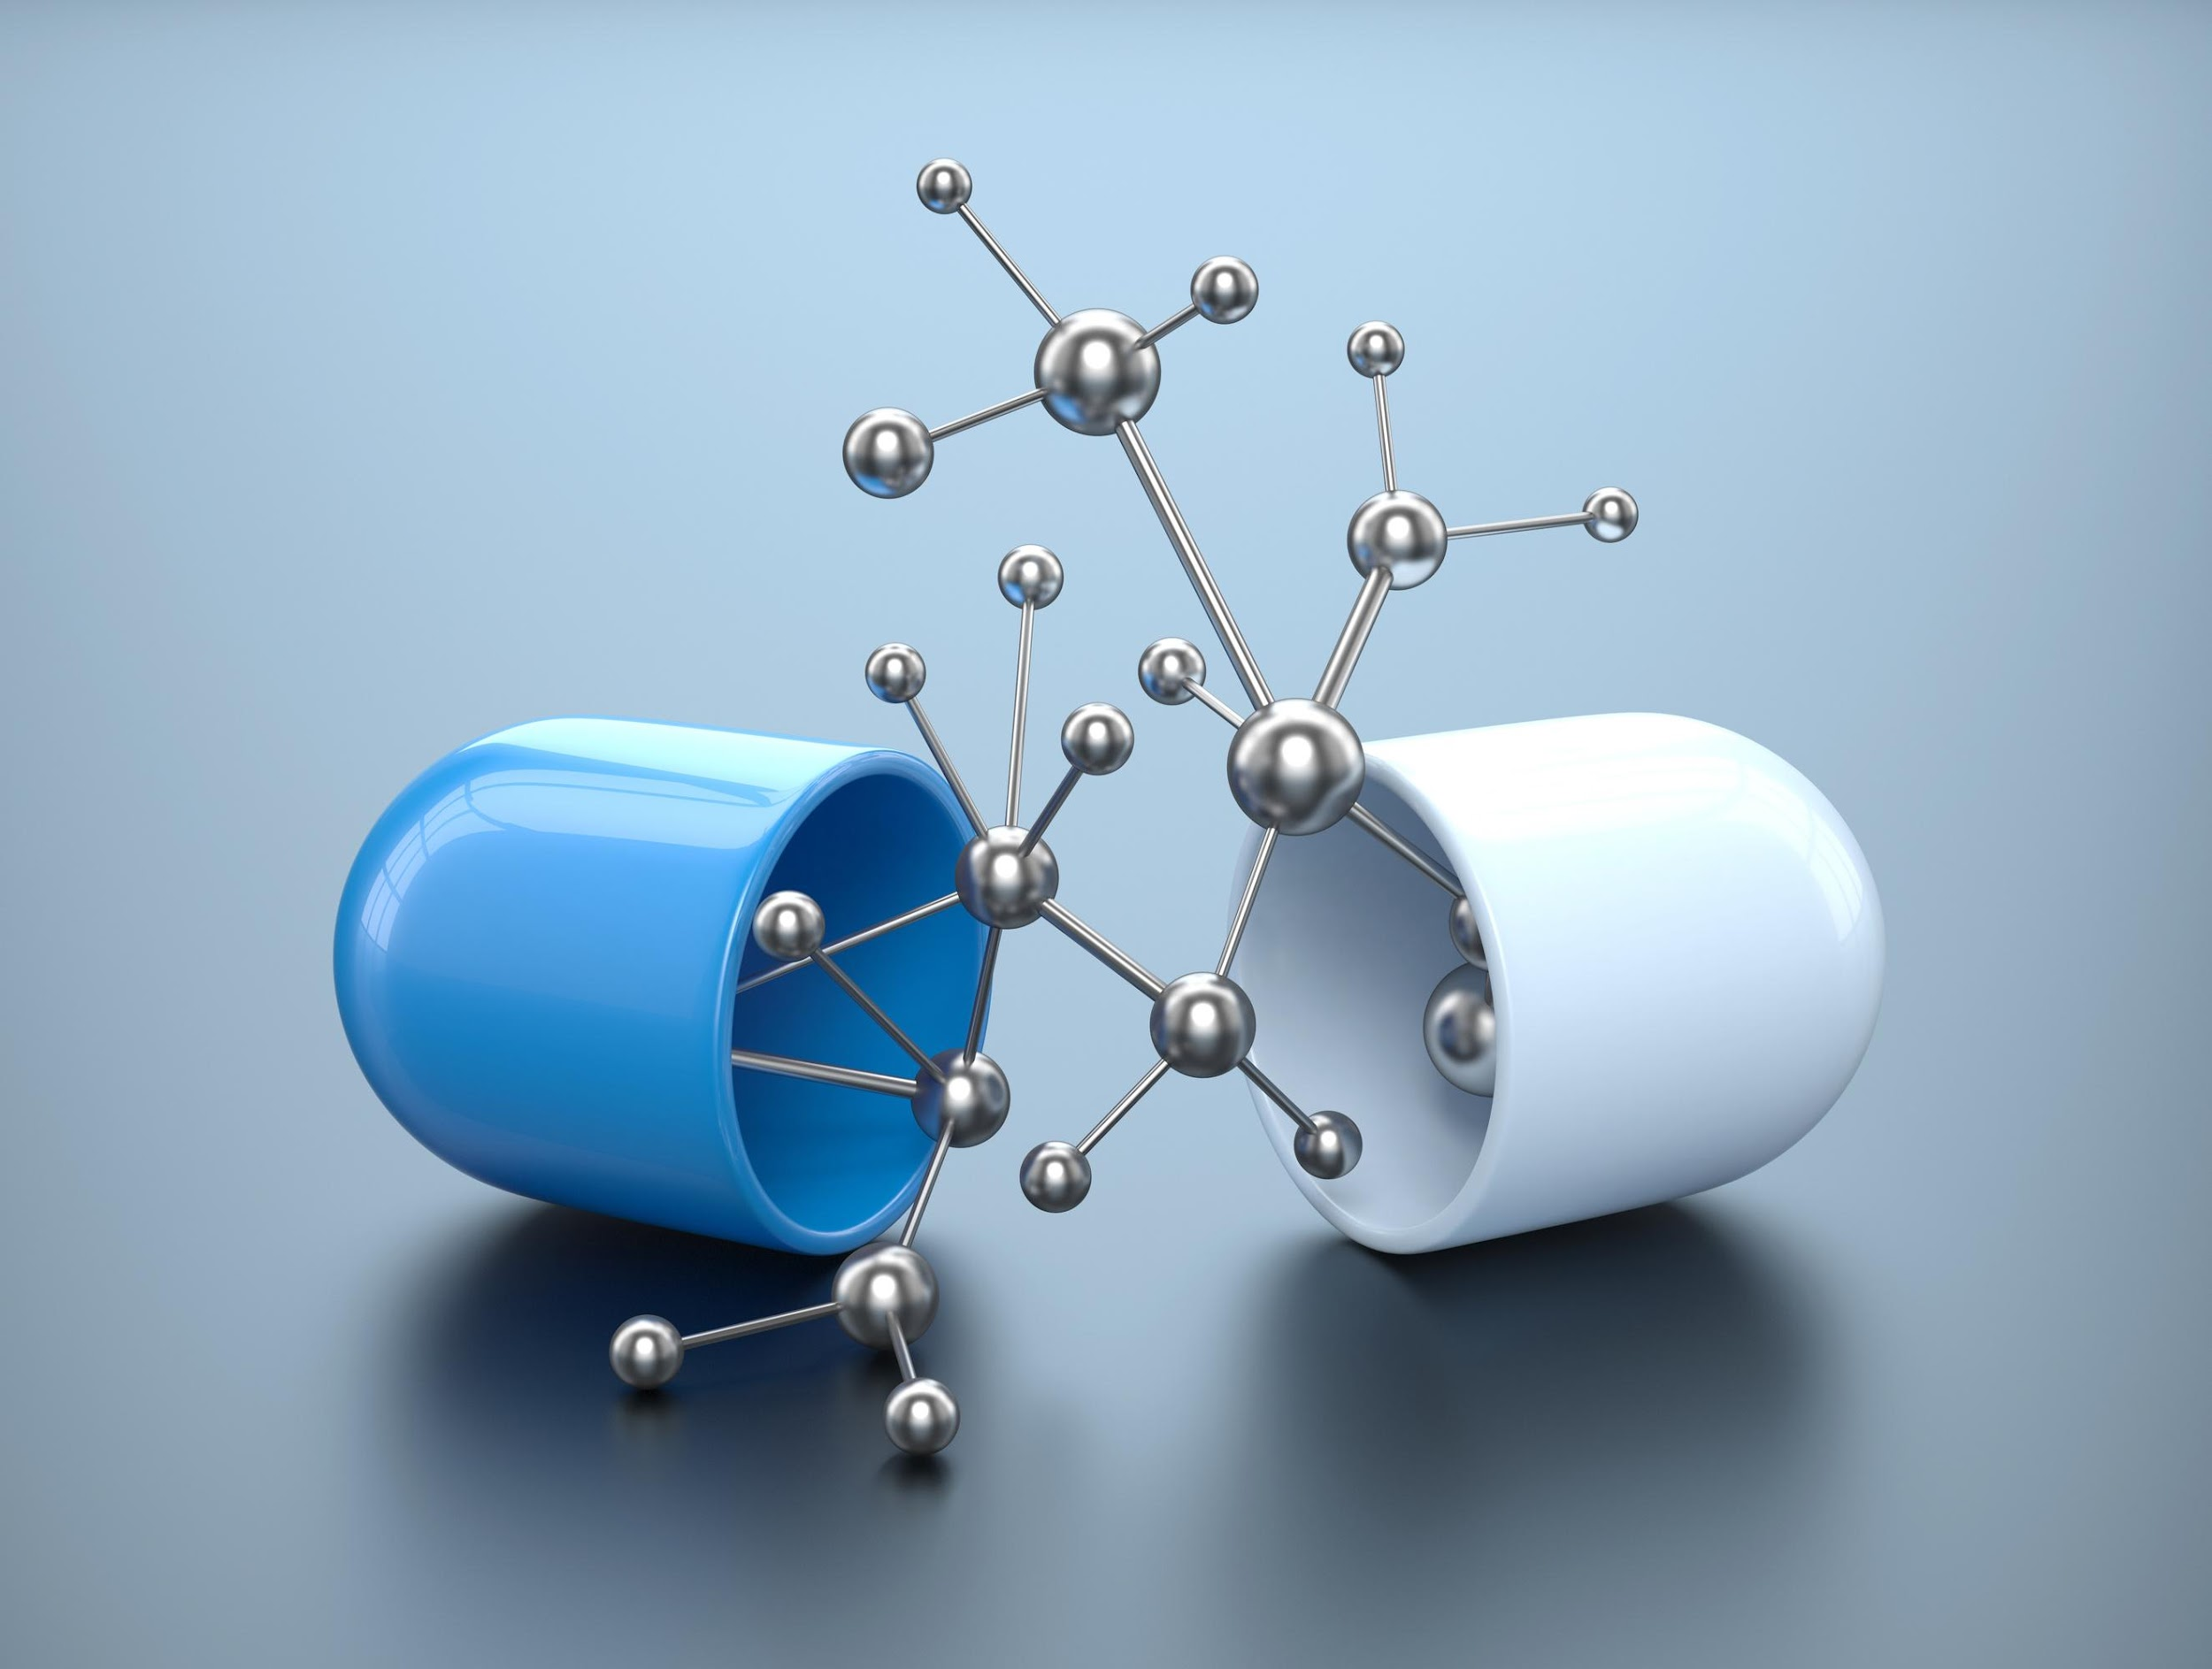

Curriculum
Trained faculty by retired industry engineers - highly specialized areas
Curriculum was developed in partnership with SBCC, UCSB, and the local industry partners
    NSF ATE Centers have developed some training programs
    SBCC sent some faculty and staff to ATE Centers to get trained

Slide 8

‘SBCC’s’ Model of Success
Micro/Nanotechnology Partnership
01
Addressing a Local Need
02
Collaborative Vision with Critical Partners
03
Mutual Interest/Gain
04
Strong, Genuine and On-Going Partnership

Slide 9
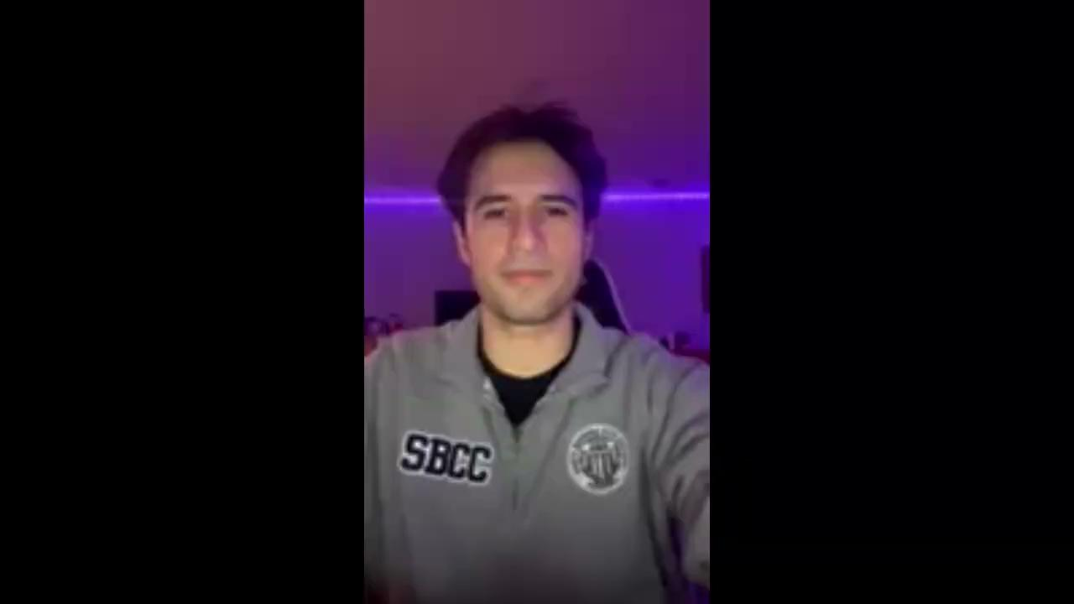
Student Testimonial
Joaquín Gutiérrez

Slide 10
Testimonials
“I had an amazing experience on the Advanced Manufacturing lab tour. The hands-on presentations were particularly impressive, as they allowed us to get up close to the equipment that is used in industry. Thank you for giving SBCC students, and us, faculty, the opportunity to make these industry connections.”
SBCC Faculty Member
“Walking into a cleanroom having to gown up for the first time and not having to worry about that, I think is helpful for confidence going into an entry-level position.”
“It would definitely help a person that has never seen a cleanroom before. The students went through all of the major tools we would use to fabricate micro devices.”
Industry Partners

Slide 11
Questions?
Thank you!

