Slide 1


NSF ATE
Labor and Economic Impact
Webcast/podcast
February 23, 2024
1:00 – 1:45 PM ET
ccpi-stem.org/webcasts-podcasts/
Funded by the National Science Foundation award #2132510
Notes:
Beth

Slide 2
Welcome and Introductions
Today’s Speakers
  Mr. Steven Partridge, Vice President, Strategy, Research and Workforce Innovation,
  Northern Virginia Community College
  Ms. Teresa Sweeney, Director, Office of Grants, Northern Virginia Community College
  Dr. LeeAnne McNulty, Director, Institutional Grants, Allan Hancock College, CA
  Prof. Erin Krier, Coordinator and Assistant Professor of Agriculture, Allan Hancock
  College, CA
  Today’s Moderator
  Dr. Elizabeth K. Hawthorne, Co-PI CCPI-STEM, PI FORCCE-ATE, and Senior Professor
  Emerita of Computer Science and Cybersecurity, Union College, NJ
ccpi-stem.org
Notes:
Beth

Slide 3
Today’s Topics
Northern Virginia Community College: Labor Market Intelligence and Impact
  Large Community College on East coast. ~75,000 students
  One of 23 colleges within the Virginia Community College System (VCCS)
Allan Hancock College: NSF ATE Grant Success and Impact
  Small Community College on West coast. ~11,000 students
  Four locations: Santa Maria Campus, Lompoc Valley Center, Santa Ynez Valley Center, and Vandenberg Space Force Base Center
Questions & Answers and Zoom Poll
ccpi-stem.org

Slide 4

Northern Virginia Community College
nvcc.edu
ccpi-stem.org

Slide 5
Labor Market Intelligence
Using local labor market information to understand and document regional workforce needs that drive NSF ATE and other grant applications
Steven Partridge
Vice President, Strategy, Research and Workforce Innovation
Teresa Sweeney
Director of Grants

Slide 6

LABOR MARKET INTELLIGENCE
Compile, analyze and communicate economic, workforce and demographic data to inform:
Program offerings and curriculum alignment
Career navigation & advising
Advisory board committee membership
Business engagement
Grants and advocacy
Community partnerships
Regional analysis & research

Slide 7



WHAT IS LABOR MARKET INTELLIGENCE (LMI)?
Economic
  Employment by industry, occupation
  Wages, prices, cost of living
  Projected employment growth
  Job openings/postings
    Employers, occupations, industries, skills, education, etc.
  Unemployment (rates, claims)
  Gross regional product
Education
  Degree awards (regional, national)
  Required levels of education, experience
  Industry-recognized certifications
  Skills and knowledge
  Employment outcomes
  (NOVA grads, aggregate)
Demographic
  Population demographics
  (age, sex, race/ethnicity)
  Worker characteristics
  Income and poverty
  Housing
  Migration
  Commuting patterns

Slide 8







LABOR MARKET DATA SOURCES & AVAILABILITY
Federal Sources |  | State Sources |  | Proprietary Sources
Foundation of all economic & demographic data Surveys (employers, workers, households); administrative data Pros: most accurate; reliable; standardized; public methodology Cons: delayed/lagged; suppression; less detailed |  | Informs federal data programs Data often offered for more geographies; additional administrative data available Pros: greater detail; accurate; reliable Cons: delayed/lagged; suppression; national comparison |  | Estimates/imputes missing federal data Scrapes/compiles online data like job postings Pros: greater detail/frequency; additional types of data; captures “emerging” fields Cons: less reliable; less comparable

Slide 9
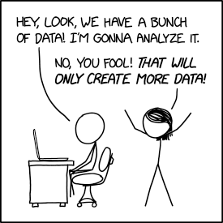
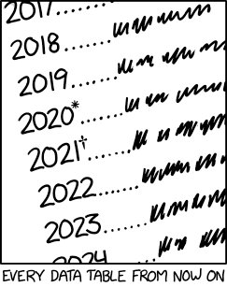
Labor Market Data Sources & availability
General Considerations
  Tradeoff between accuracy/reliability and detail/timeliness
  Labor market data generalizes, requiring translation to specific industries, jobs, skills, etc.
    e.g., occupations & industries rarely match reality perfectly
  Most numbers are estimates, and estimates always have a certain amount of error
  Data is never “just the data”—relies on definition and comparison
  Data isn’t free – good data takes time & effort

Slide 10
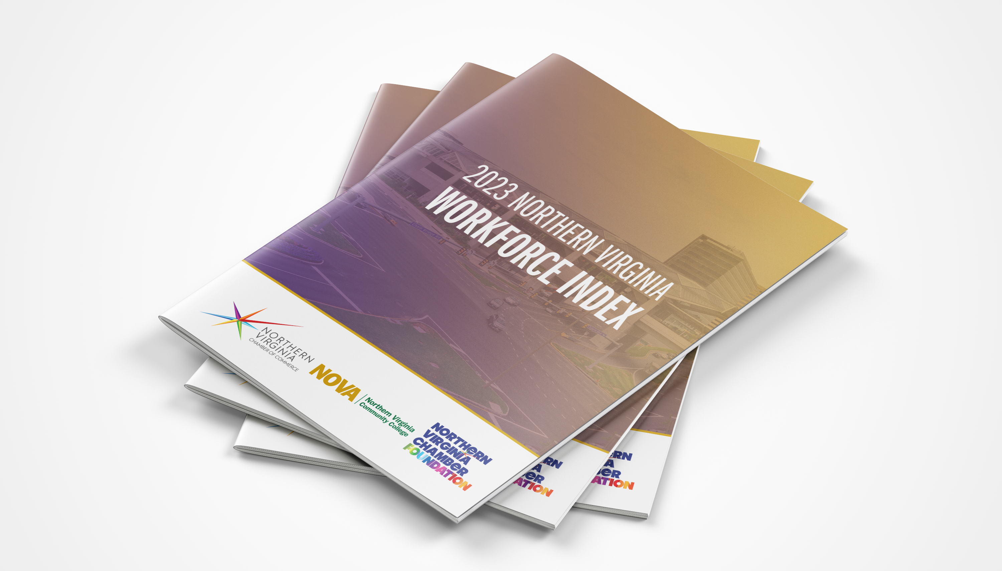

Slide 11
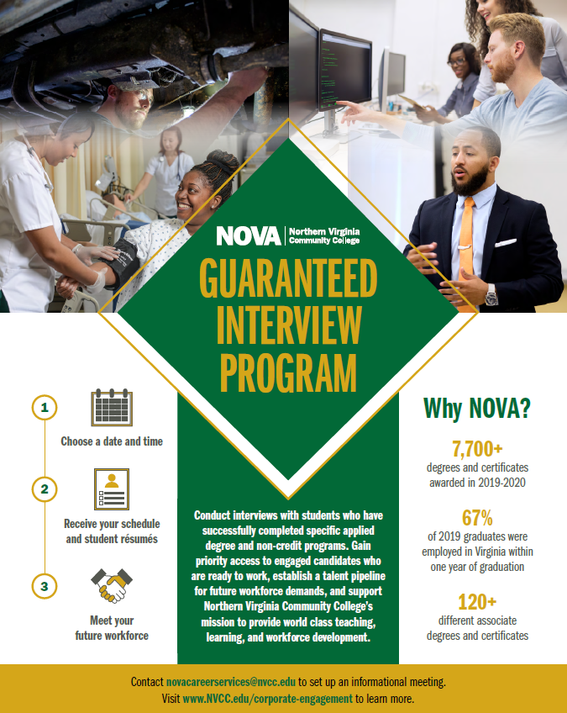
MAKING IT POSSIBLE:
NOVA’S BUSINESS ENGAGEMENT CENTER
NOVA’s Business Engagement Center—the first of its kind at a community college in the U.S.—is a one-stop shop for all industry partnerships and collaborations.
https://www.nvcc.edu/bec/index.html
Through our Guaranteed Interviews program, employers get the first chance to hire our in-demand, highly-valued career pathway grads.
https://www.nvcc.edu/bec/guaranteed-interviews.html

Slide 12
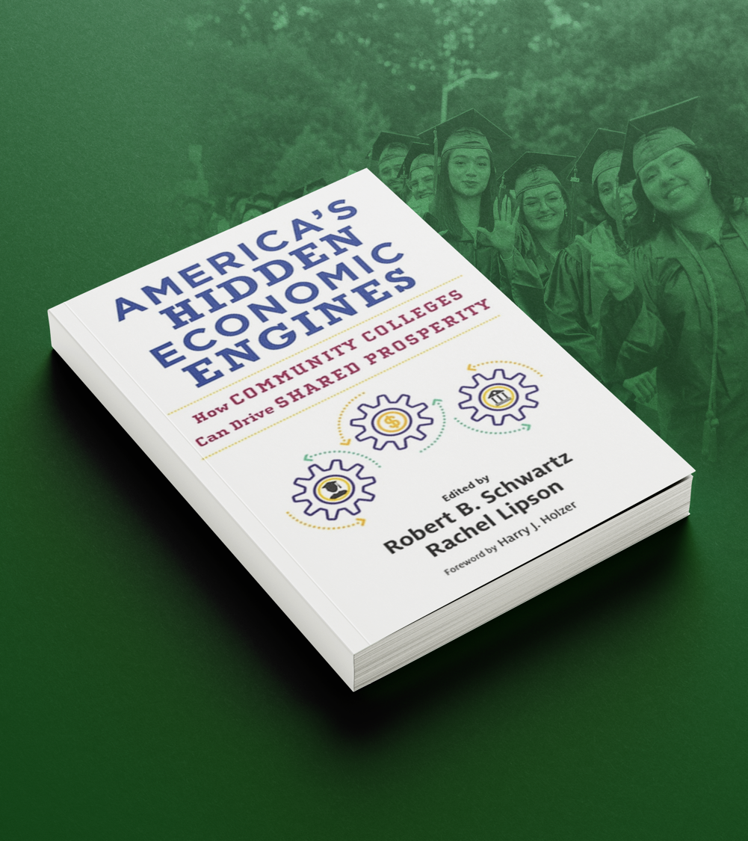
Lessons from Five Colleges:
Set the Tone and Vision
  Leadership Matters at Every Level
Focus on Regional Industries
  Understand the Needs—Current and Future—of the Local Economy
Center Employment Outcomes
Make Connecting Students to Economic Opportunities Mission Critical
Build Deep Partnerships
Shift to Long-Term Relationships with Employers, Away from Short-Term Transactions

Slide 13
NOVA and NSF
During NOVA’s history of submitting NSF grants, we have:
  Won 21 grants with a total value of $7,539,360
  Submitted 9 additional proposals in 2023 with a potential value of $4,826,297
Among all types of NSF subprograms, the greatest number of proposals submitted and grants awarded have been under ATE (Advanced Technological Education)

Slide 14
NOVA and NSF
In choosing sources of LMI data to use in proposals, we focus on the following factors:
  Produced within the last 2-3 years
  Representative of the same or similar geographic region as the area to be served by the project - local, regional, state or a combination
  Representative of the same or similar target populations to be served by the project
  Industry and partner-company specific jobs data related to the LMI data and cross-referenced with NOVA certification and degree programs that are central to the project design and expected improvements or outcomes

Slide 15
NOVA and NSF
“NOVA Biotechnology Leadership in Education (NOBLE)” started May 2023. Proposal included research and LMI data from several sources as part of its rationale, such as:
  Virginia’s biotechnology industry growth, including companies such as Ceres Nanosciences, Orpheus Bioscience, GlaxoSmithkline, Inova Health System
  Regional job statistics for previous 3 years and forecasted job growth/need through 2028 (28% per year) in the life sciences
  Monetary investment in life sciences industry for previous 3 years of $1.2 billion (Virginia Economic Development Partnership and Virginia Works data)
  Specific biotechnology need and growth sectors (e.g., medical technology and bioinformatics) and how they relate to NOVA degrees/certifications and student data (e.g., demographics, enrollment and completion in our Biotechnology Program offerings)

Slide 16

Allan Hancock College
hancockcollege.edu
ccpi-stem.org

Slide 17
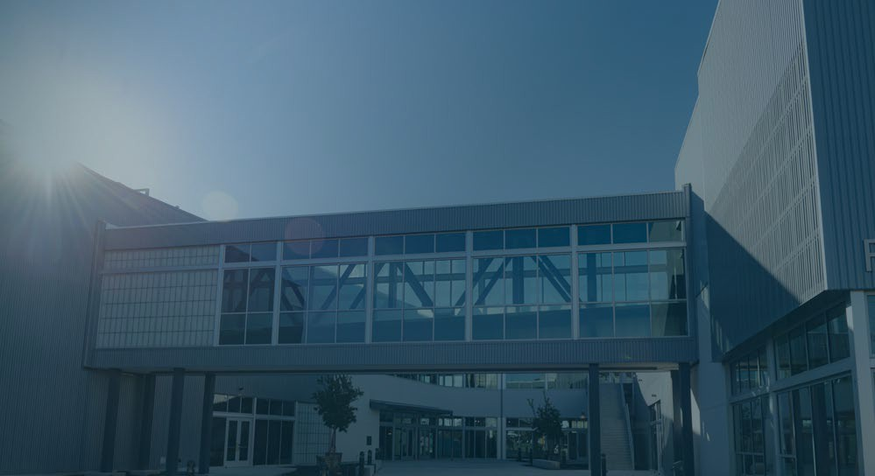

Allan Hancock College’s NSF – ATE Grant
Presented by:
Erin Krier, AG FT Faculty and Program Coordinator erin.krier@hancockcollege.edu
LeeAnne McNulty, Director, Institutional Grants leeanne.mcnulty@hancockcollege.edu

Slide 18

KEVIN G. WALTHERS, PH.D
A L L A N H A N C O C K C O L L E G E
P r esid en t ’ s Of f ice
Welcome and thank you for your interest in Allan Hancock College’s National Science Foundation grants.
Grants are one of the strategies AHC uses to
Change the Odds.

Slide 19


Determined Grant was Needed by Examining the Data
From 2018 to 2028, the
Agricultural production
Employment Development Department projects the state agricultural cluster will add nearly 65,000 between 2018-2028. The number of openings projected estimate: over 18% for agriculture managers, technicians, and scientists
contributes $1.8 billion to the Santa Barbara County economy
(SB County Agricultural Commissioner’s Office, 2020)
Agriculture support systems which include mechanized agriculture components had annual sales volume of $2.5 billion in the central coast region in 2018 according to the UC (University of California, 2019)
New jobs in agriculture will be much more technical than existing jobs, and growth in the industry will be achieved through technological productivity gains rather than through increasing jobs
(California Employment Development Department, 2023)

Slide 20
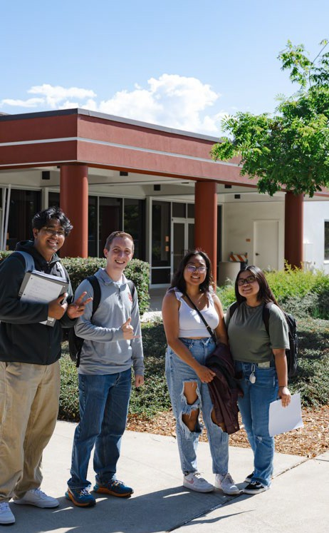
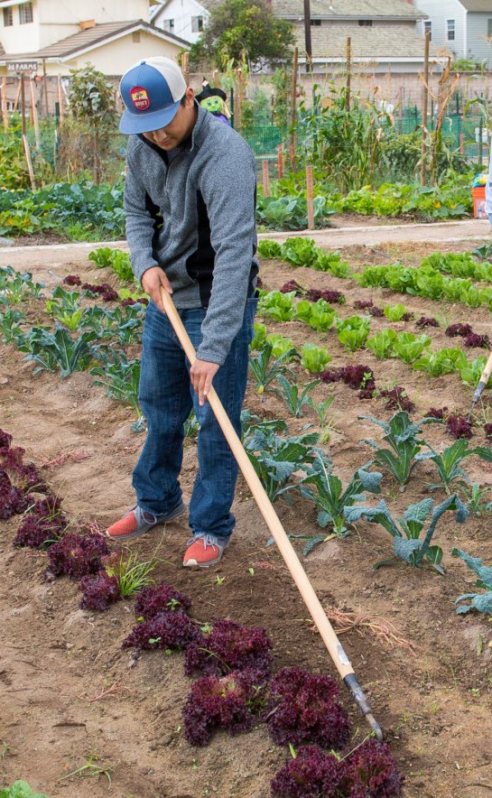
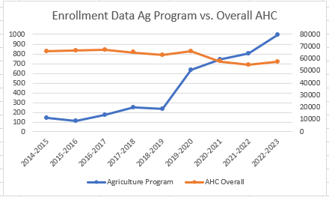
The Goal of the NSF ATE Grant was to grow and expand Agriculture pathways
“

Slide 21

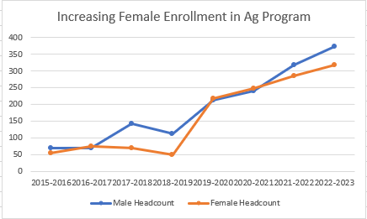
Increase Female Enrollments
“

Slide 22
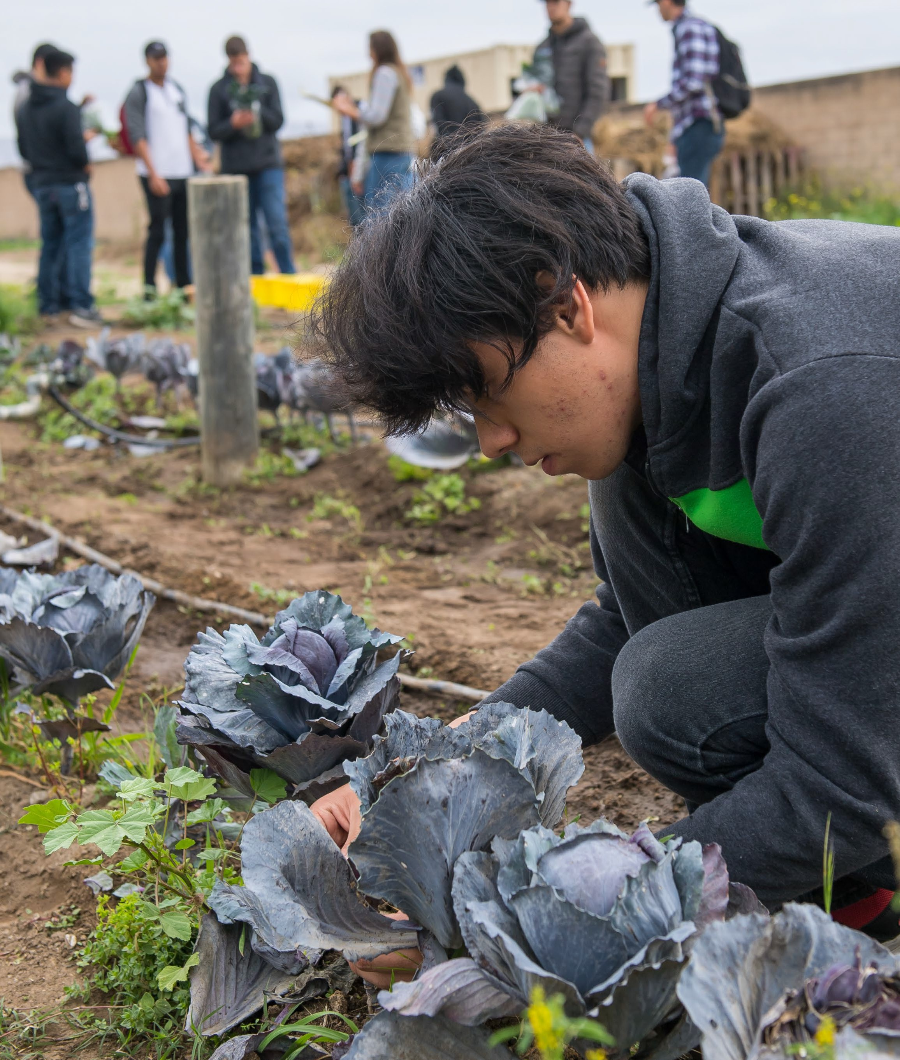
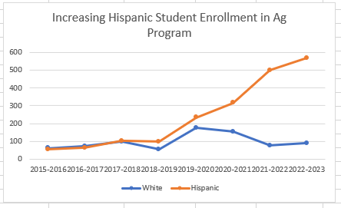
Increase Hispanic Enrollments
“

Slide 23
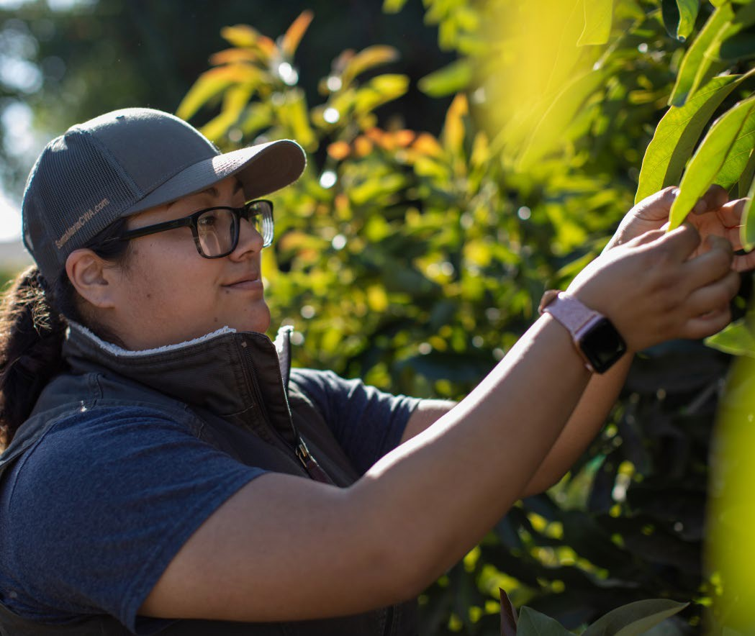

How did we know it was time to write a grant?
.
Matched the Mission, Vision, and Goals of the College
The department agreed upon the goals and activities
We had a champion
Brought grant goals, objectives, and activities to shared governance for transparency
Enthusiastic industry support

Slide 24

A L L A N
H A N C O C K
C O L L E G E
Through this project, AHC aspired to match the high demand for crop protection and precision agriculture technicians by creating associate degrees for transfer as well as industry recognized certification programs through newly created pathways at the community college level.

Slide 25

A L L A N
H A N C O C K
C O L L E G E
Once the Grant Was Awarded
Planning and Implementation meetings
Budget Preparation within Business Services
Timeline and Check-ins
Curriculum Development
Academic Process to Institute Class Offerings
Purchasing Supplies and Equipment
Coordinating with Public Affairs to promote the new programs
Industry Partnerships and Guidance – robust BILT
High school and community outreach
Internships and Paid work Experience

Slide 26

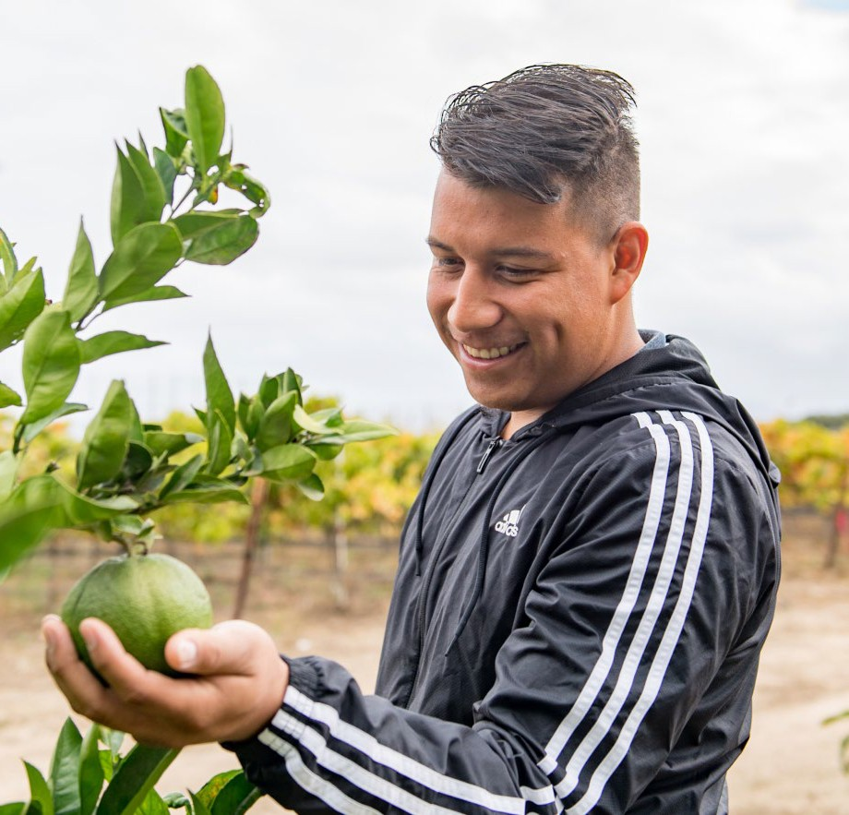
Challenges
Navigating curriculum development processes
Lab space/ Scheduling
Insufficient administrative and farm management staffing
Coordinating the timing of grant expectations and reality (i.e.: C-19 Pandemic)
“

Slide 27
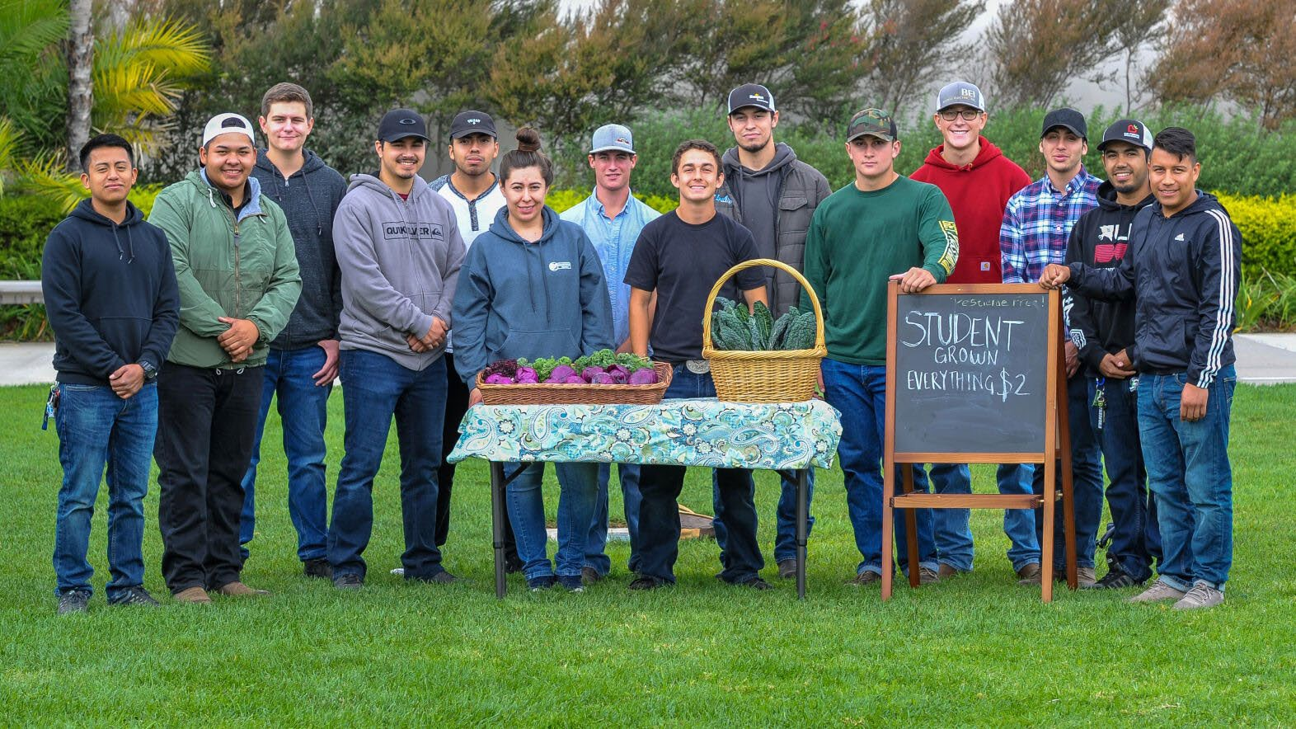
Leveraging the College Infrastructure
A L L A N H A N C O C K C O L L E G E
Grants Office helps to get grants off the ground by creating timelines, plans, data collection, and budget set-up
Business Services – Fiscal Reporting and Compliance
Public Affairs – Promotion
Academic Affairs – Scheduling
Deans – Hiring
Career Center - Partnership / Outreach
CTE Grants – Financial Back-up
Student Activities – clubs, outreach events

Slide 28

Institutionalization
A L L A N H A N C O C K C O L L E G E
Allan Hancock College dramatically expanded its agriculture course, certificate, and degree offerings.
Creating Precision Agriculture and Crop Protection Pathways via Industry Partnerships” (NSF Award #1800889, $269,220;
2018-2021 with extension through 2023), resulted in the development of degrees in Agricultural Science, Agricultural Plant Science, and Agricultural Business

Slide 29
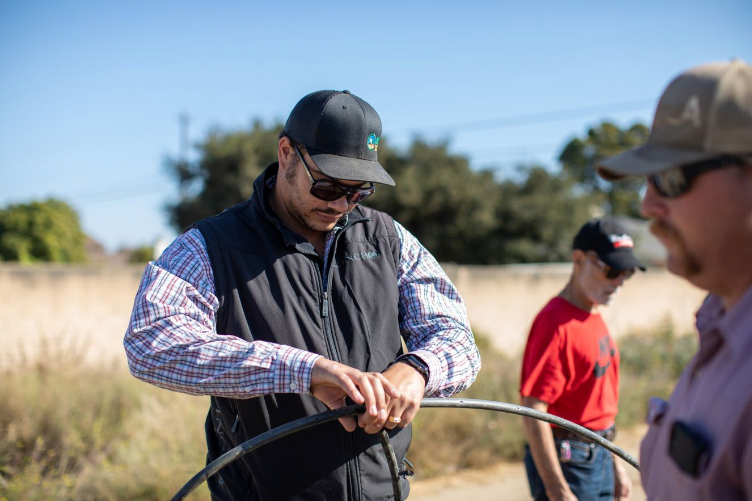
Institutionalization
A L L A N H A N C O C K C O L L E G E
Certificates in Crop Protection and Pest Control Adviser Preparation were created.
Established a new Precision Agriculture program including one new course in precision agriculture which will combine with existing agriculture, industrial technology, and Geographic Information Systems (GIS) courses as a new certificate and degree in Precision Agriculture.

Slide 30
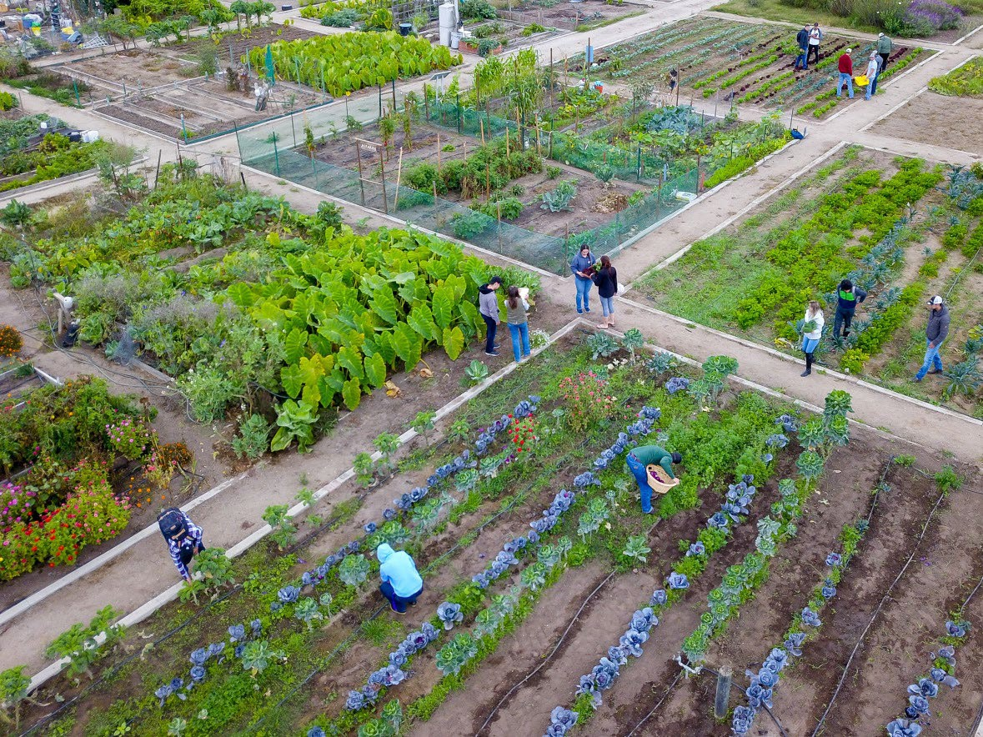
Institutionalization
A L L A N H A N C O C K C O L L E G E
Courses were created and implemented as a result of NSF ATE grant funding: Introduction to Agriculture Studies and Careers, Agricultural Plant Pathology, Economic Entomology, Weed Science, Qualified Applicator Training, Agriculture Production Enterprise Fall, Spring, and Summer, and Introduction to Precision Agriculture (Current Course Catalog, 2023; Current Programs, 2023)

Slide 31
Upcoming CCPI-casts
Community College Collaborations with Business & Industry
Fri, March 22 @ 1:00 pm ET
CCPI-STEM Fellows: A Unique Opportunity
Fri, April 26 @ 1:00 pm ET
Visit ccpi-stem.org to RSVP and receive a Zoom confirmation
ccpi-stem.org

Slide 32


leadership@ccpi-stem.org
Questions / Comments / Poll
ccpi-stem.org
linkedin.com/company/community-college-presidents-initiative/
Notes:
Reminder: launch poll questions

